Slide 1
JSON in Python
The full-form of JSON is JavaScript Object Notation.
Python has a built-in package called json, which can be used to work with JSON data JSON is a syntax for storing Lists, bools, numbers, tuples and dictionaries and exchanging data.
Encode Python objects as JSON strings, and decode JSON strings into Python objects
To use this feature, we import the json package in Python script.
The text in JSON is done through quoted string which contains value in key-value mapping within { }. It is similar to the dictionary in Python.
JSON is a pure string written in a convention format, which does not have any characteristics of data structure.
The Python dict string uses single quotation marks, and JSON enforces double quotation marks.
You can nest tuple in Python dict. JSON can only use array.

Slide 2
Convert from Python to JSON
Encode Python objects as JSON strings, and decode JSON strings into Python objects
If you have a Python object, you can convert it into a JSON string by using the json.dumps() method.
Python | JSON
dict | Object
list | Array
tuple | Array
str | String
int | Number
float | Number
True | true
False | false
None | null

Slide 3
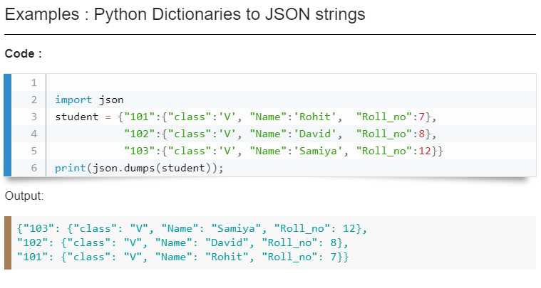
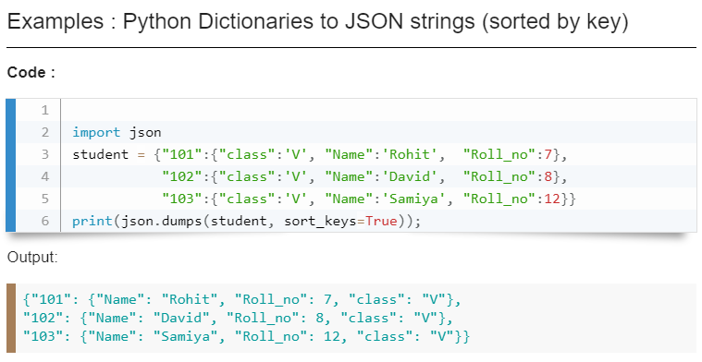

Slide 4
Convert Python objects into JSON strings, and print the values:
import json
print(json.dumps({"name": "John", "age": 30})) print(json.dumps(["apple", "bananas"])) print(json.dumps(("apple", "bananas"))) print(json.dumps("hello")) print(json.dumps(42)) print(json.dumps(31.76)) print(json.dumps(True)) print(json.dumps(False)) print(json.dumps(None))
{"name": "John", "age": 30} ["apple", "bananas"] ["apple", "bananas"] "hello" 42 31.76 true false null
Output::

Slide 5
Convert a Python object containing all the legal data types:
import json x = { "name": "John", "age": 30, "married": True, "divorced": False, "children": ("Ann","Billy"), "pets": None, "cars": [ {"model": "BMW 230", "mpg": 27.5}, {"model": "Ford Edge", "mpg": 24.1} ] } print(json.dumps(x))
Output:
{"name": "John", "age": 30, "married": true, "divorced": false, "children": ["Ann","Billy"], "pets": null, "cars": [{"model": "BMW 230", "mpg": 27.5}, {"model": "Ford Edge", "mpg": 24.1}]}

Slide 6
Format the Result:
The example above prints a JSON string, but it is not very easy to read, with no indentations and line breaks.
The json.dumps() method has parameters to make it easier to read the result:
Example
Use the indent parameter to define the numbers of indents:
json.dumps(x, indent=4)
print(json.dumps(x, indent=4))
You can also define the separators, default value is (", ", ": "), which means using a comma and a space to separate each object, and a colon and a space to separate keys from values:
Example
Use the separators parameter to change the default separator:
json.dumps(x, indent=4, separators=(". ", " = "))

Slide 7
using indent parameter:
using indent parameter and Seperator parameter :
{ "name" = "John". "age" = 30. "married" = true. "divorced" = false. "children" = [ "Ann". "Billy" ], "pets" = null. "cars" = [ { "model" = "BMW 230". "mpg" = 27.5 }. { "model" = "Ford Edge". "mpg" = 24.1 } ] }
{ "name": "John", "age": 30, "married": true, "divorced": false, "children": [ "Ann", "Billy" ], "pets": null, "cars": [ { "model": "BMW 230", "mpg": 27.5 }, { "model": "Ford Edge", "mpg": 24.1 } ] }

Slide 8
Parse JSON - Convert from JSON to Python
Decode JSON strings into Python objects
If you have a JSON string, you can parse it by using the json.loads() method. You can use json.load() method to read a file containing JSON object This method returns python dictionary.
import json
# some JSON:
x = '{ "name":"John", "age":30, "city":"New York"}'
# parse x:
y = json.loads(x)
# the result is a Python dictionary:
print(y)
Output:
{'name': 'John', 'age': 30, 'city': 'New York'}

Slide 9
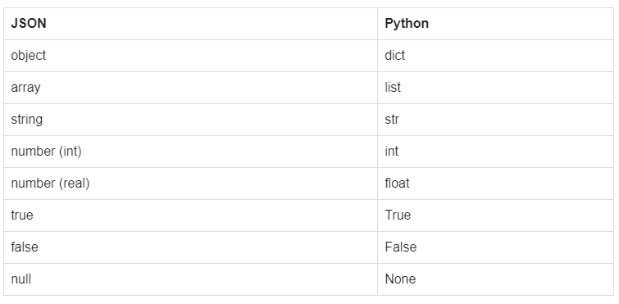
Convert from JSON to Python:

Slide 10
import json
# some JSON boolean , null value , array:
x = '{ "bool1":true, "bool2":false, "city":null, "array“ :[1,2,3]}'
# parse x:
y = json.loads (x)
# the result is a Python dictionary:
print(y)
Output:
{'bool1': True, 'bool2': False, 'city': None, 'array': [1, 2, 3]}

Slide 11
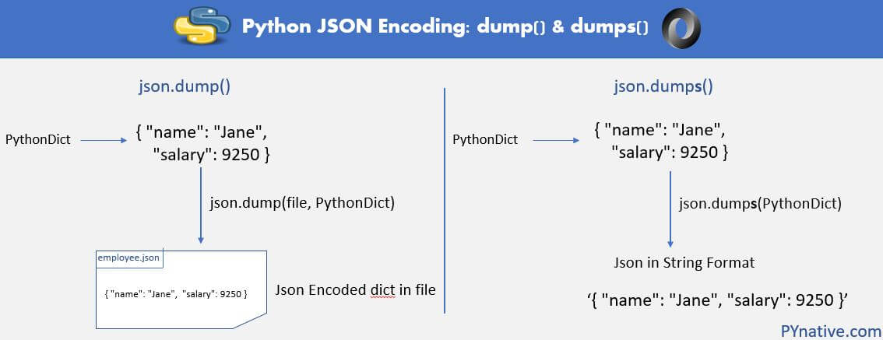
Writing JSON to a file
The json.dump() method (without “s” in “dump”) used to write Python serialized object as JSON formatted data into a file. The file type can be anything including text, JSON or even binary file.
The json.dumps() method encodes any Python object into JSON formatted String.

Slide 12
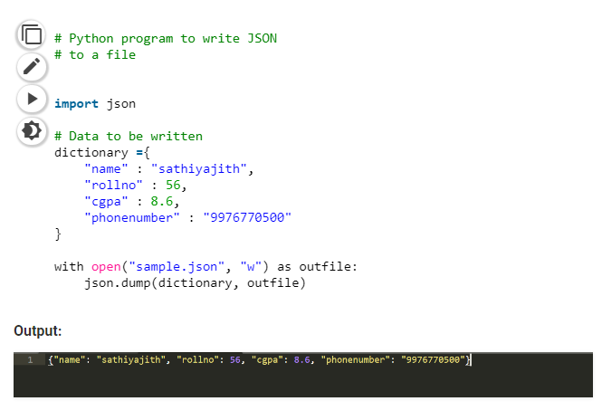
It takes 2 parameters: dictionary – name of dictionary which should be converted to JSON object.
file pointer – pointer of the file opened in write or append mode.

Slide 13
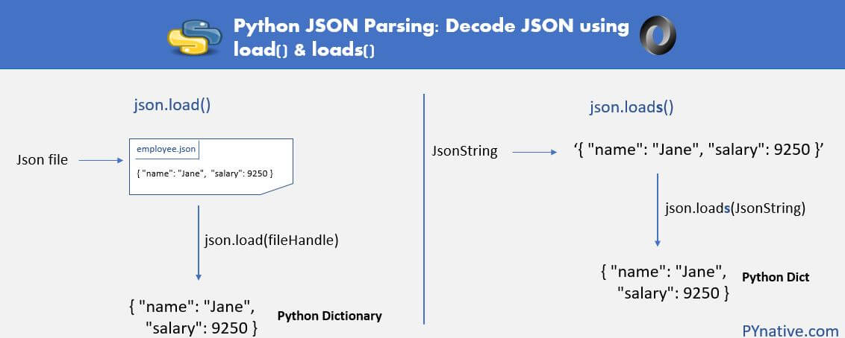
Python read JSON file
json.load() method (without “s” in “load”) used to read JSON encoded data from a file and convert it into Python dictionary.
json.loads() method, which is used for parse valid JSON String into Python dictionary.

Slide 14
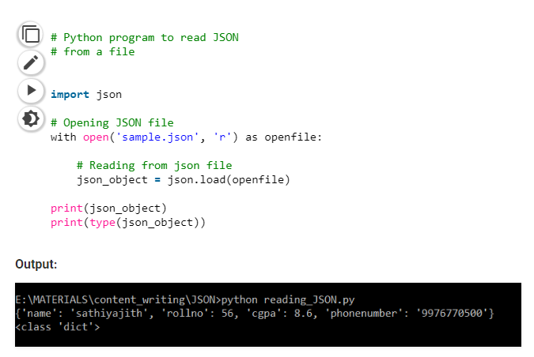
It takes one parameter:
File pointer: A file pointer that points to a JSON file.

Slide 15
References
https://www.w3schools.com/python/python_json.asp
https://www.w3resource.com/JSON/python-json-module
https://www.geeksforgeeks.org/reading-and-writing-json-to-a-file-in-python/
https://www.programiz.com/python-programming/json

